Slide 1
PathFinder
CS 6334.001 VR Project
Group 1: Saffat Ahmed, Aidan Gow, Rachel Pitts, Akhil Shashi

Slide 2
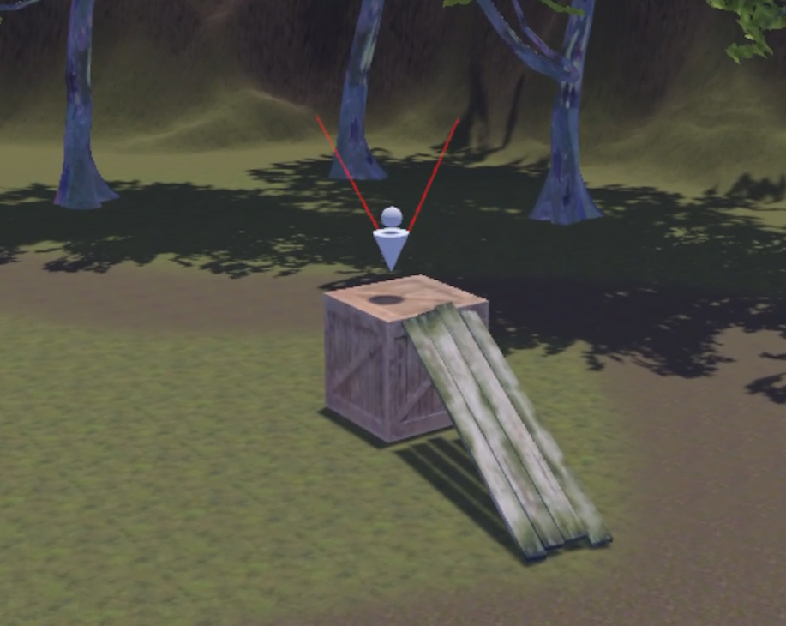
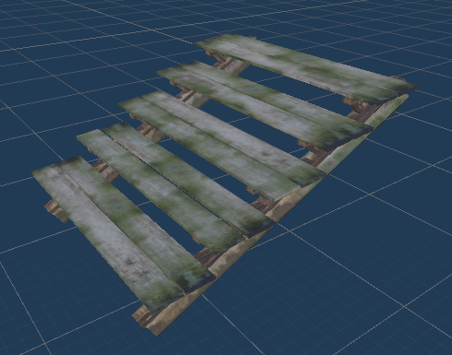
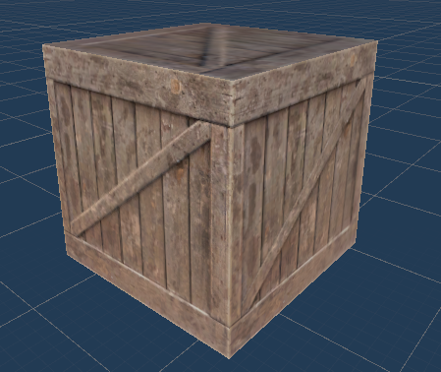
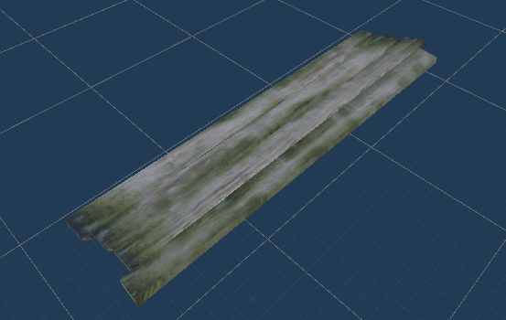
Introduction
A VR game where the player can use various objects to create paths.
Different objects serve different purposes, so the player must figure out which object and configuration is best for a given situation.

Slide 3

System Overview
Unity Engine
Implemented our VR system using the XR Interaction Toolkit
Handling objects
Tracking head to camera movements
Continuous Move and Snap Turn Providers
Used free assets from the Unity Asset Store

Slide 4
System Implementation
Movement
Continuous Move Provider
Player Controller implements the jump and sprint actions
Camera
Incorporated First POV and Third POV with ability to switch freely between the two cameras
Third POV mainly used to prevent motion sickness for some users if the player movement is too disorienting
Snap Turn Provider
XR Rig tracks the headset movement to the First POV camera
Object Interaction
XR Controller for the player to be able to pick up and manipulate certain objects
Interactable Manager tracks objects and respawns/deletes objects depending on their distance from their initial position

Slide 5
Assets
Nature - Essentials
Cloth Animate Based Flag
Wooden Crates
Realistic Tree 9 [Rainbow Tree]
Free Rocks
Rock and Boulders 2
Terrain Sample Asset pack
Flooded Grounds
Pixel Cursors
Modular Wooden Bridge Tiles
Starter Assets - First Person Character Controller
Freesound

Slide 6
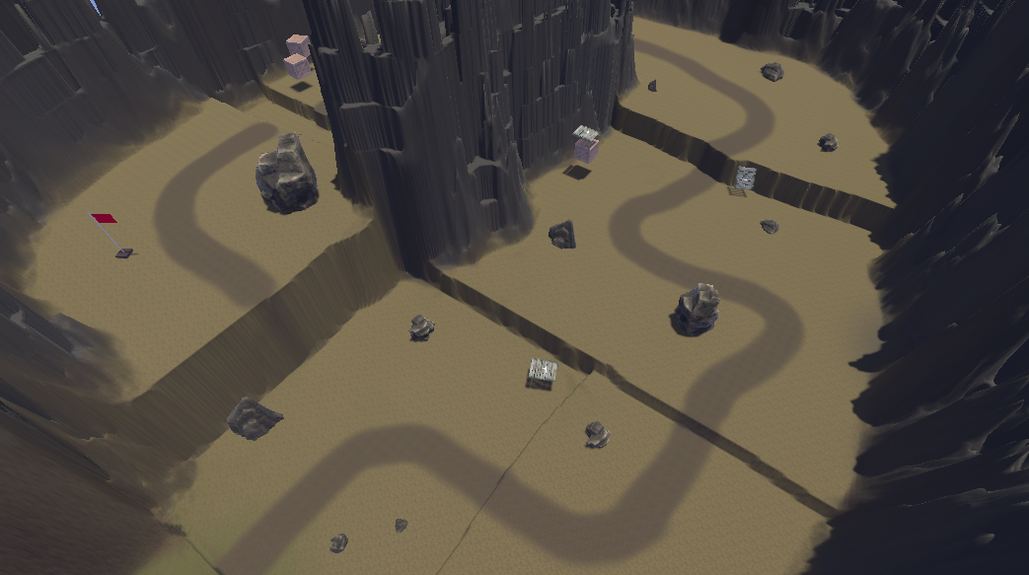
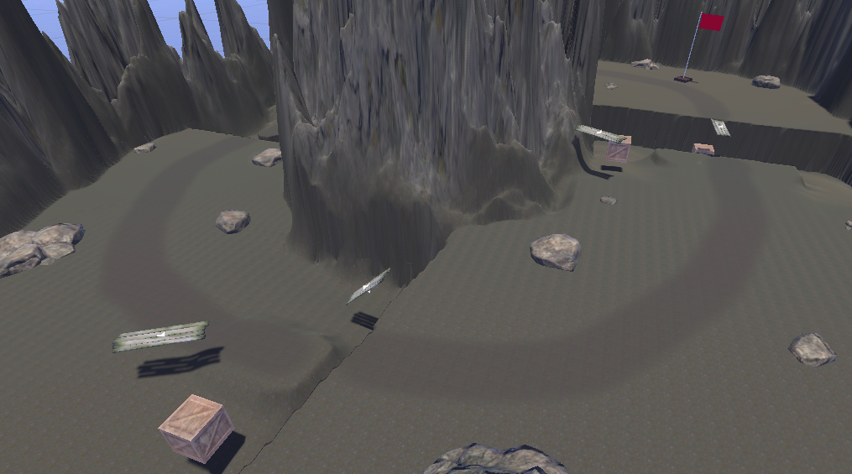
Game Overview
Using Unity’s Terrain feature, we create three areas
A starting area for the player to get comfortable with the controls and handling of the objects
Two obstacle courses to challenge the player in different situations
The player is required to use nearby object to overcome a given obstacle

Slide 7
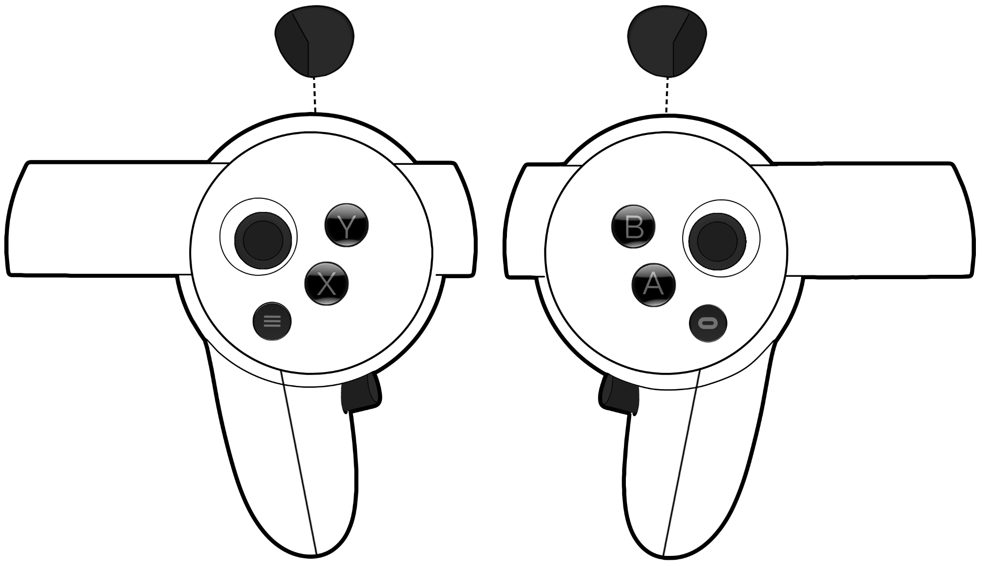
Controls
Switch Camera (1st/3rd POV)
Sprint
Rotate Object / Snap Turning
Jump
Move Player
Grab Object
Enable Snap Turning

Slide 8
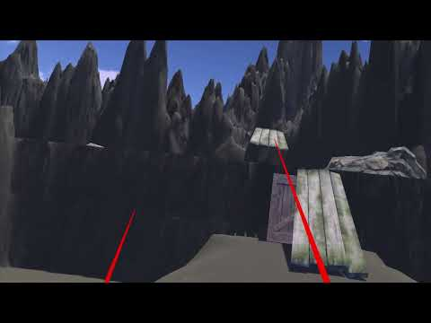
Video Demo
https://www.youtube.com/watch?v=dEsBIIr60HY

Slide 9
Questions?

